Slide 1
Book Recommendation System Using IBM Watson
TEAM DETAILS:
UFAIRA TAZHEEN (18UK1A05B4)
BOLUKONDA YASHASWI (18UK1A05C6)
SUJAY CHELLA (18UK1A05B0)
AKULA LOKESH (18UK1A05C1)

Slide 2
CONTEXT:
INTRODUCTION
OBJECTIVE
DATA
DATA VISUALIZATION
MODEL CREATION
VISUALIZATION OF GRAPHS
SOFTWARE REQUIREMENTS
CONCLUSION

Slide 3

INTRODUCTION:
In this age of information overload, people use a variety of strategies to make choices about what to buy, how to spend their leisure time, and even where to go. Recommendation systems automate some of these strategies with the goal of providing affordable, personal and high-quality recommendations. So, with the help of different techniques like collaborative and content-based filtering, we can build our own recommendation systems.
The main objective of the project is to build an application where the user is prompted with various types of book recommendations based on the input given by the user.

Slide 4
OBJECTIVE:
By the end of this project:
You’ll be able to perform one of the techniques to build you recommendation system
You will be able to know how to pre-process / clean the data using different data pre-processing techniques.
You will able to analyze or get insights of data through visualization.
Applying algorithms according to dataset and based on visualization.
You will able to know how to find accuracy of the model.
You will be able to know how to build a web application using Flask framework.

Slide 5
DATA:
The data set consists of 3 csv files in which we have the sample data. They are
Users.
Book.
Book-ratings.

Slide 6
DATA VISUALIZATION:
Data Visualization is an increasingly central activity in the field of Analytics. We often talk about Data
Design, that is, a structured approach to creating visual and interactive reports that allow those who observe
them to easily interpret them and quickly grasp the most significant information.
Analyzing the data collected by your ERP or your CRM observing the visual representation allows you to:
· understand them faster and more thoroughly
· make better predictions
· share your analyzes more easily
· guide the decision-making process
· discover new points of view

Slide 7
MODEL CREATION:
TO BULID A MODEL HERE WE USED K-NEAREST NEIGHBOUR ALGORITHM
K-NEAREST NEIGHBOUR:
K-Nearest Neighbour is one of the simplest Machine Learning algorithms based on Supervised Learning technique.
K-NN algorithm assumes the similarity between the new case/data and available cases and put the new case into the category that is most similar to the available categories.
K-NN algorithm stores all the available data and classifies a new data point based on the similarity. This means when new data appears then it can be easily classified into a well suite category by using K- NN algorithm.

Slide 8
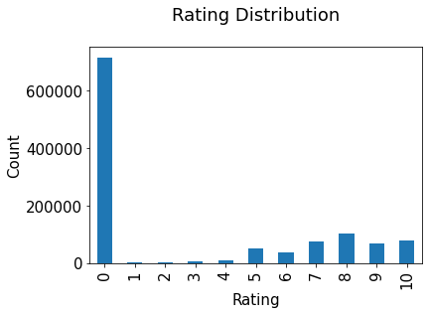
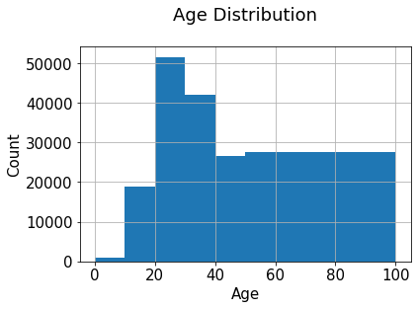
VISUALIZATION OF GRAPHS:

Slide 9
SOFTWARE REQUIREMENTS:
Google colab
Anaconda navigator
Jupyter notebook
Machine learning tools :
- Pandas
- NumPy
- Matplotlib
- Seaborn

Slide 10
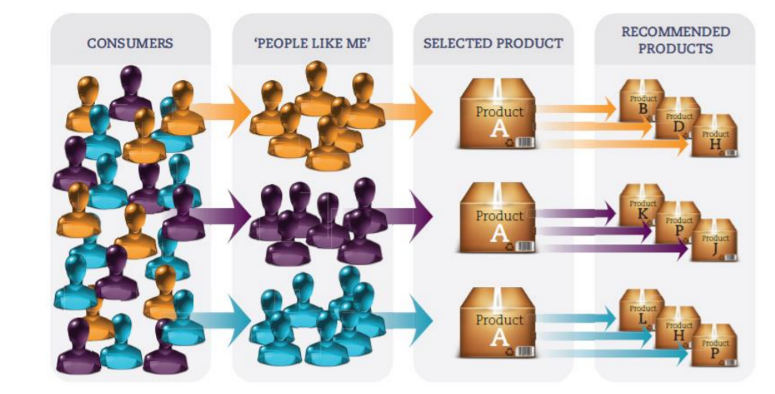
CONCLUSION:
Recommender systems are an extremely potent tool utilized to assist the selection process easier for users. The implemented book recommendation engine is a competent system to recommend Books for e-users. This recommender system will definitely be a great web application implemented in Java language. Such type of web application will be proved beneficial for today’s high demanding online purchasing web sites. This hybrid recommender system is more accurate and efficient as it combines the features of various recommendation techniques. The book recommendation engine will reduce the overhead associated with making the best choices of books among the plenty.

